Slide 1

NAME: Aniqa Razzaq , Laraib Asghar SAP: 47557 , 47065 BATCH: FALL2022 BSCS SUBMITTED TO: Ma’am Madiha SUBMISSION DATE: 14 JUNE , 2023
oop( object oriented programming)
STUDENTS MANAGEMENT SYSTEM
Project presentation

Slide 2

OBJECTIVES :
Our project name is STUDENT MANAGEMENT SYSTEM. This software is helpful for students as well as the school authorities. In the current system all the activities are done manually. It is very time consuming and costly. Our Student Management System deals with the various activities related to the students. In the System the user has a power to add new Students, delete Students, show Students, modify and search the Students.
ABSTRACT :
Our main focus is to design a unique Student Management System that will improve data management in institutes, experience for both students and administration authorities. The system is written in C++ language. The project aim is to manage and update information of students.

Slide 3

INTRODUCTION:
The Student Management System can handle all the details about a Student. The details include students name, address, email, contact, course. The Student Management System is an automated version of manual Student Management System.
WE USE :
CLASES
DIFFERENT HEADER FILES
INHERITANCE
IF-ELSE Statement
SWITCH Statements
CONSTRUCTORS
GETTER SETTER
FILE HANDLING
FUNCTIONS
POINTERS
INPUT VALIDATION
Classes :
Course Class , Student Class

Slide 4
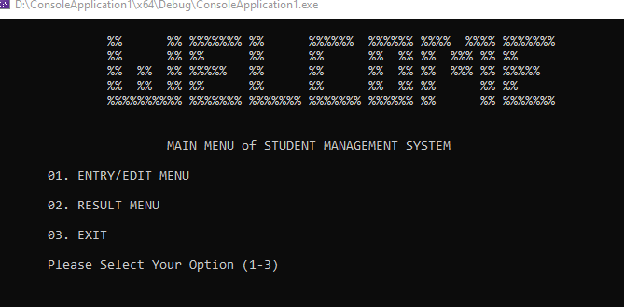
Header Files: iostream, fstream, iomanip , conio.h FUNCTIONS: 1. void course::calculate() 2. void Student::create( ) 3. void Student::Show_report( ) 4. void Student::update( ) 5. void Student::delete( ) 6. void Student::display( ) 7. void Student::class_result( ) 8. void Student::student_result( ) 9. Global menu function() 10. Loginsystem & Signup
Menu Function:
When you run the code, this function calls first because it is used to take the choice of the user, that what he wants to do in the system.
1. Create 2. Show_report 3. Update 4. Delete 5. Display 6. Class_Result
7. Student_result

Slide 5
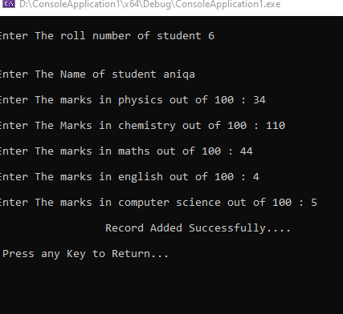
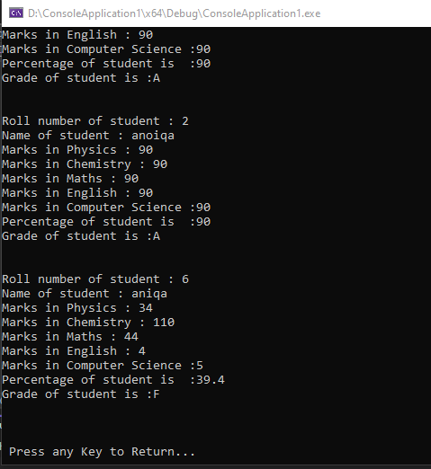
Create Function: When the user wants to enter the record of the new student then he calls a create function. Then he/she adds name, roll number, subject course marks of the student. The user presses 1 to call the create function.
Display Function:
If the user wants to see all the student records in the system, then display function show all the present students in the system.
The record include the students name, roll number, subject course marks of the student . The user presses 6 to call the display function.

Slide 6
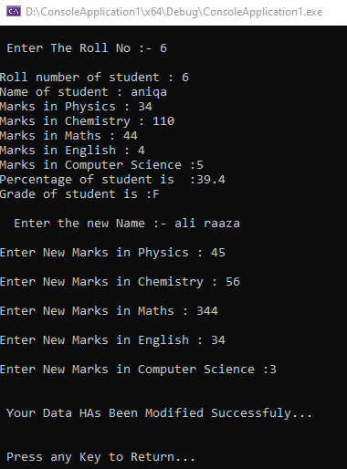
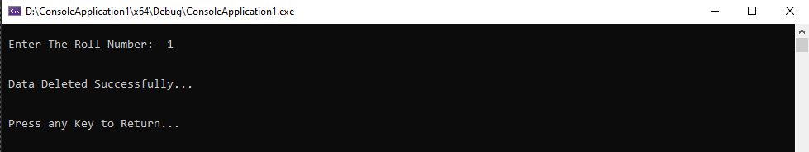
Update Function:
If the user wants to update anything in the student record, then user choose the update function to update that record.
User enters student roll number which he wants to update, through roll number our system find that student record and then updates that student record as user wants.
The user presses 4 to call the update function.
Search Function:
If user wants to search specific record from the system, then he calls the search function.
It displays that specific record which user wants, by searching that record of the student.
If no student present in the system, then the user gets No student is found message.
The user presses 4 to call the search function.

Slide 7
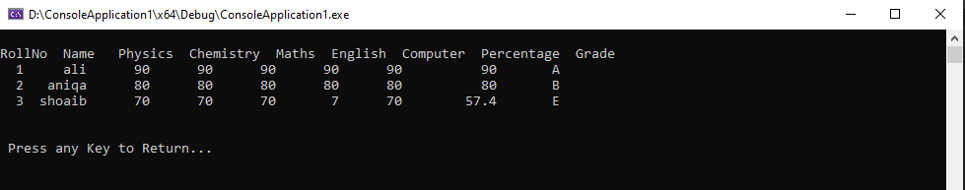
Delete Function:
If user wants to delete any specific record of the student, then this function deletes that student.
If user doesn’t present in the system, then user gets No student found message. If present then message display “Successfully Deleted Student Data”.
The user presses 5 to call the delete function.
Class Result:

Slide 8
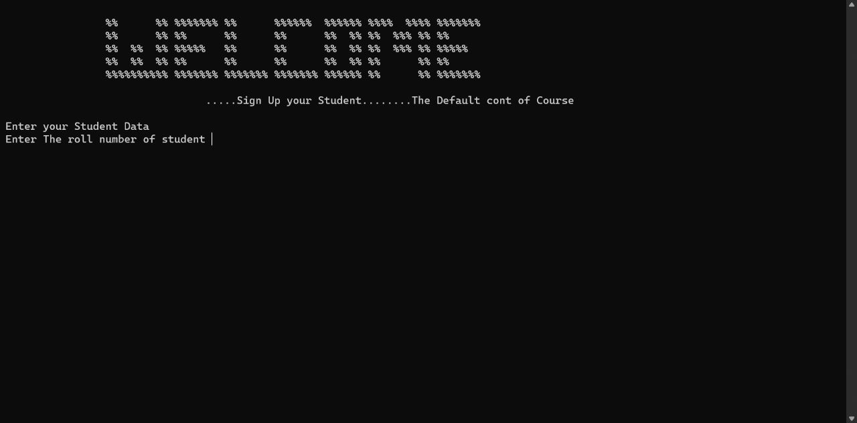
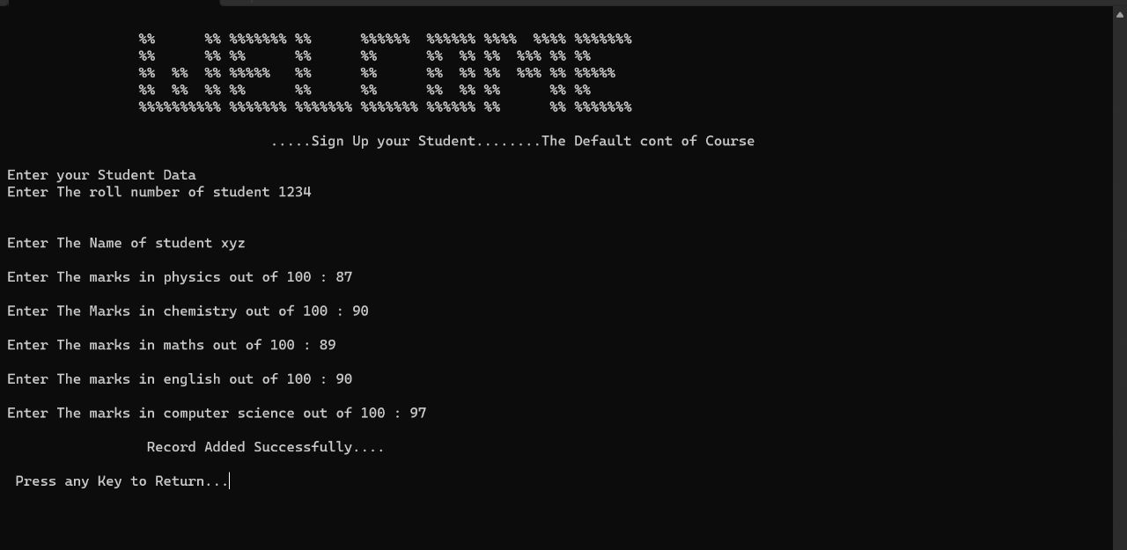
Login Screen:
SignUp Screen:

Slide 9
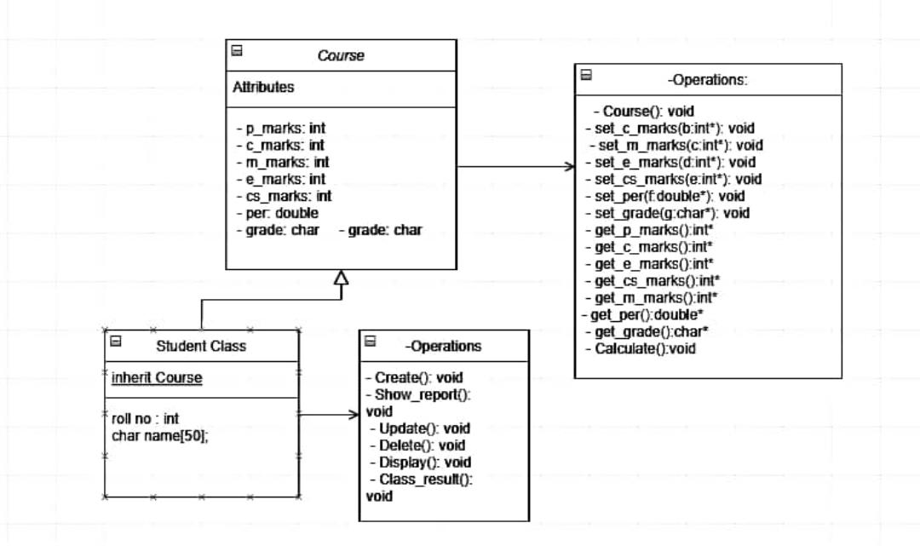
UML Diagram:

